Slide 1
The CALL Verb

Slide 2
Objectives
Define CALL statement
CALL BY CONTENT/REFERENCE
Define LINKAGE SECTION
Cover LINKAGE SECTION & JCL Parameters
IS EXTERNAL phrase

Slide 3
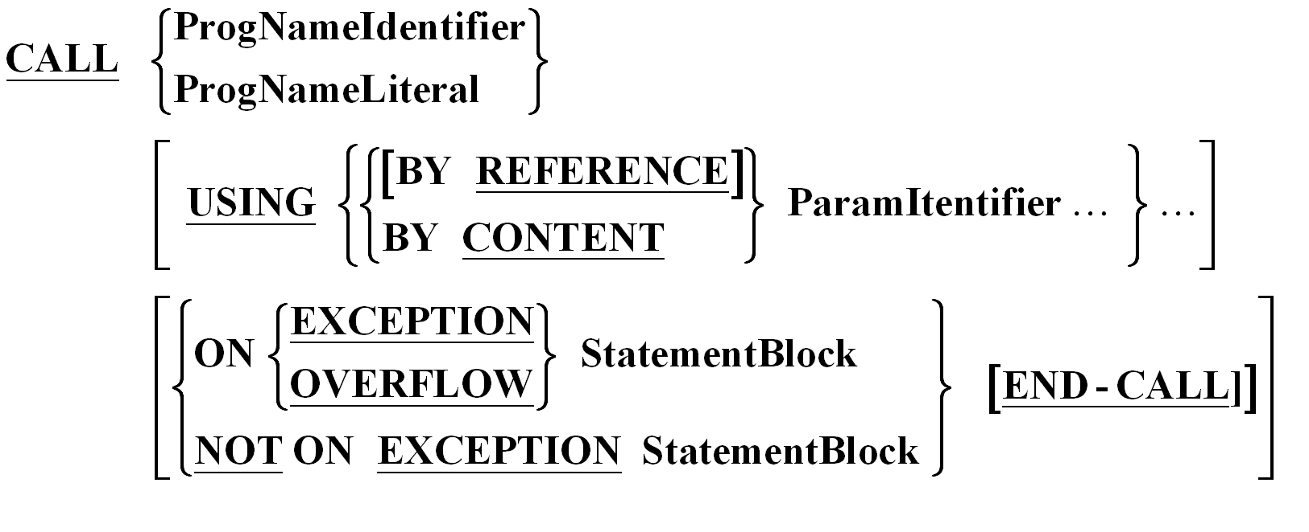
CALL Syntax
CALL statement transfers control from one object program to another within run unit

Slide 4
CALL Example
CALL “PROGA” USING….
ON EXCEPTION SET GOOD-CALL TO TRUE
NOT ON EXCEPTION SET BAD-CALL TO TRUE
END-CALL

Slide 5
CALL BY CONTENT/REFERENCE
CALL BY REFERENCE technique allows the sub-program to access and process the data-items in the caller’s storage
CALL BY CONTENT technique allows the sub-program to access and process a copy of the data-items from the caller’s storage. The sub-program can not change the original data values in the caller’s storage

Slide 6
LINKAGE SECTION
The LINKAGE SECTION of DATA DIVISION describes data made available from another program
Value clause can not be specified for items other than level-88 items
EXTERNAL clause can not be specified in LINKAGE SECTION

Slide 7
CALL with LINKAGE Example
DATA DIVISION.
…
WORKING-STORAGE SECTION.
01 PARM-LIST.
05 PART-NO PIC X(4).
05 USA-SALES PIC 9(5).
…
PROCEDURE DIVISION.
…
CALL “PROGA”
USING PARM-LIST.
…
PROGA
LINKAGE SECTION.
01 USING-LIST.
10 PART-ID PIC X(4).
10 SALES PIC 9(5).
PROCEDURE DIVISION
USING USING-LIST.
….
GOBACK.

Slide 8
LINKAGE SECTION & JCL Parameters
User-parameters can be passed to the COBOL program being executed via the PARM parameter of the EXEC statement:
//STEPNAM EXEC PGM=XXXX,…,
// PARM=‘USER-PARAMETER’
Access to the user-parameter string requires LINKAGE SECTION definitions:
  LINKAGE SECTION.
  01 PARM-VAL.
    05 PARM-VALUE PIC X(10).
    05 PARM-LEN PIC S9(4) COMP.
PROCEDURE DIVISION USING PARM-VAL.

Slide 9
IS EXTERNAL phrase
FDEntry/WSRecordEntry IS EXTERNAL
FD FileArea IS EXTERNAL
WORKING-STORAGE SECTION.
01 SharedRec IS EXTERNAL.
05 PART-ID PIC X(5).
05 SALES PIC 9(5).
SharedRec Area can be used by multiple programs to share the data

Slide 10
Thank you!

